Slide 1


Brain Tumour Detection Using Machine Learning
Presented By:
Kamala Thapa (21185159)
Sankalpa Adhikari (21185177)
Sushil Adhikari (21185185)

Slide 2

Presentation Outline
A roadmap of our discussion on brain tumour detection using machine learning.
Problem & Context
Goals & Uses
Understanding the challenge of brain tumour diagnosis.
Defining project aims and real-world impact.
Methodology & Tools
Architecture Overview
Exploring the machine learning techniques and functionalities.
Visualizing the system's structure and components.
Outcomes & Constraints
Summary & Future Steps
Anticipated findings, performance, and boundaries.
Key takeaways, suggested improvements, and sources.

Slide 3
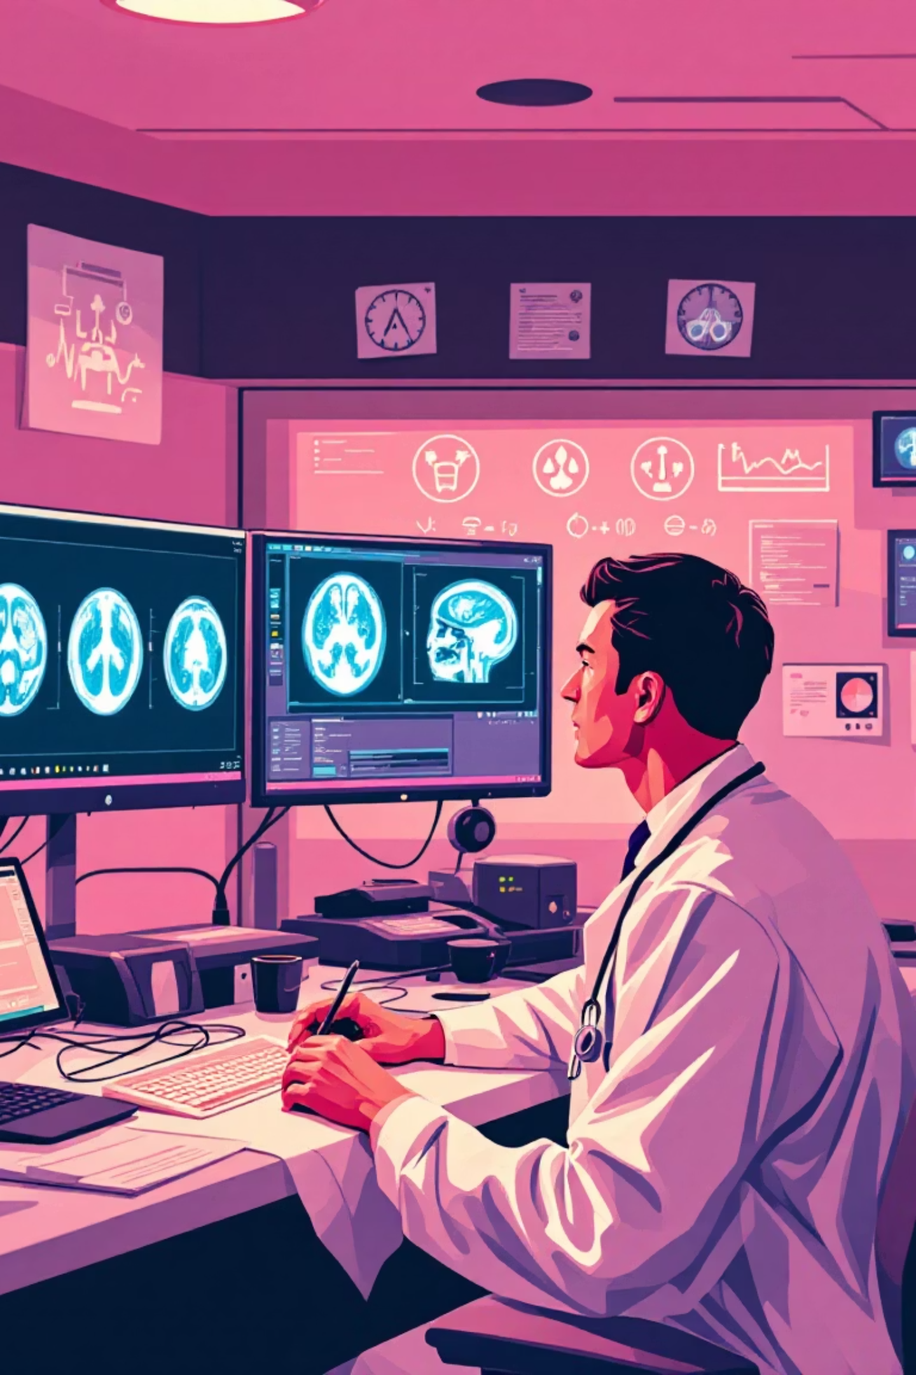
Problem Statement & Background
High MRI volumes and radiologist shortages—especially in developing regions—cause diagnostic delays. Manual MRI analysis is time-consuming and inconsistent. This project aims to build a CNN-based system to automatically and accurately identify brain tumours from MRI images to enable earlier diagnoses and improved patient outcomes.
Clinical Need
Faster, consistent MRI interpretation to reduce diagnostic backlog.
Technical Opportunity
Deep learning (CNNs) enables automated feature learning from MRI images.

Slide 4
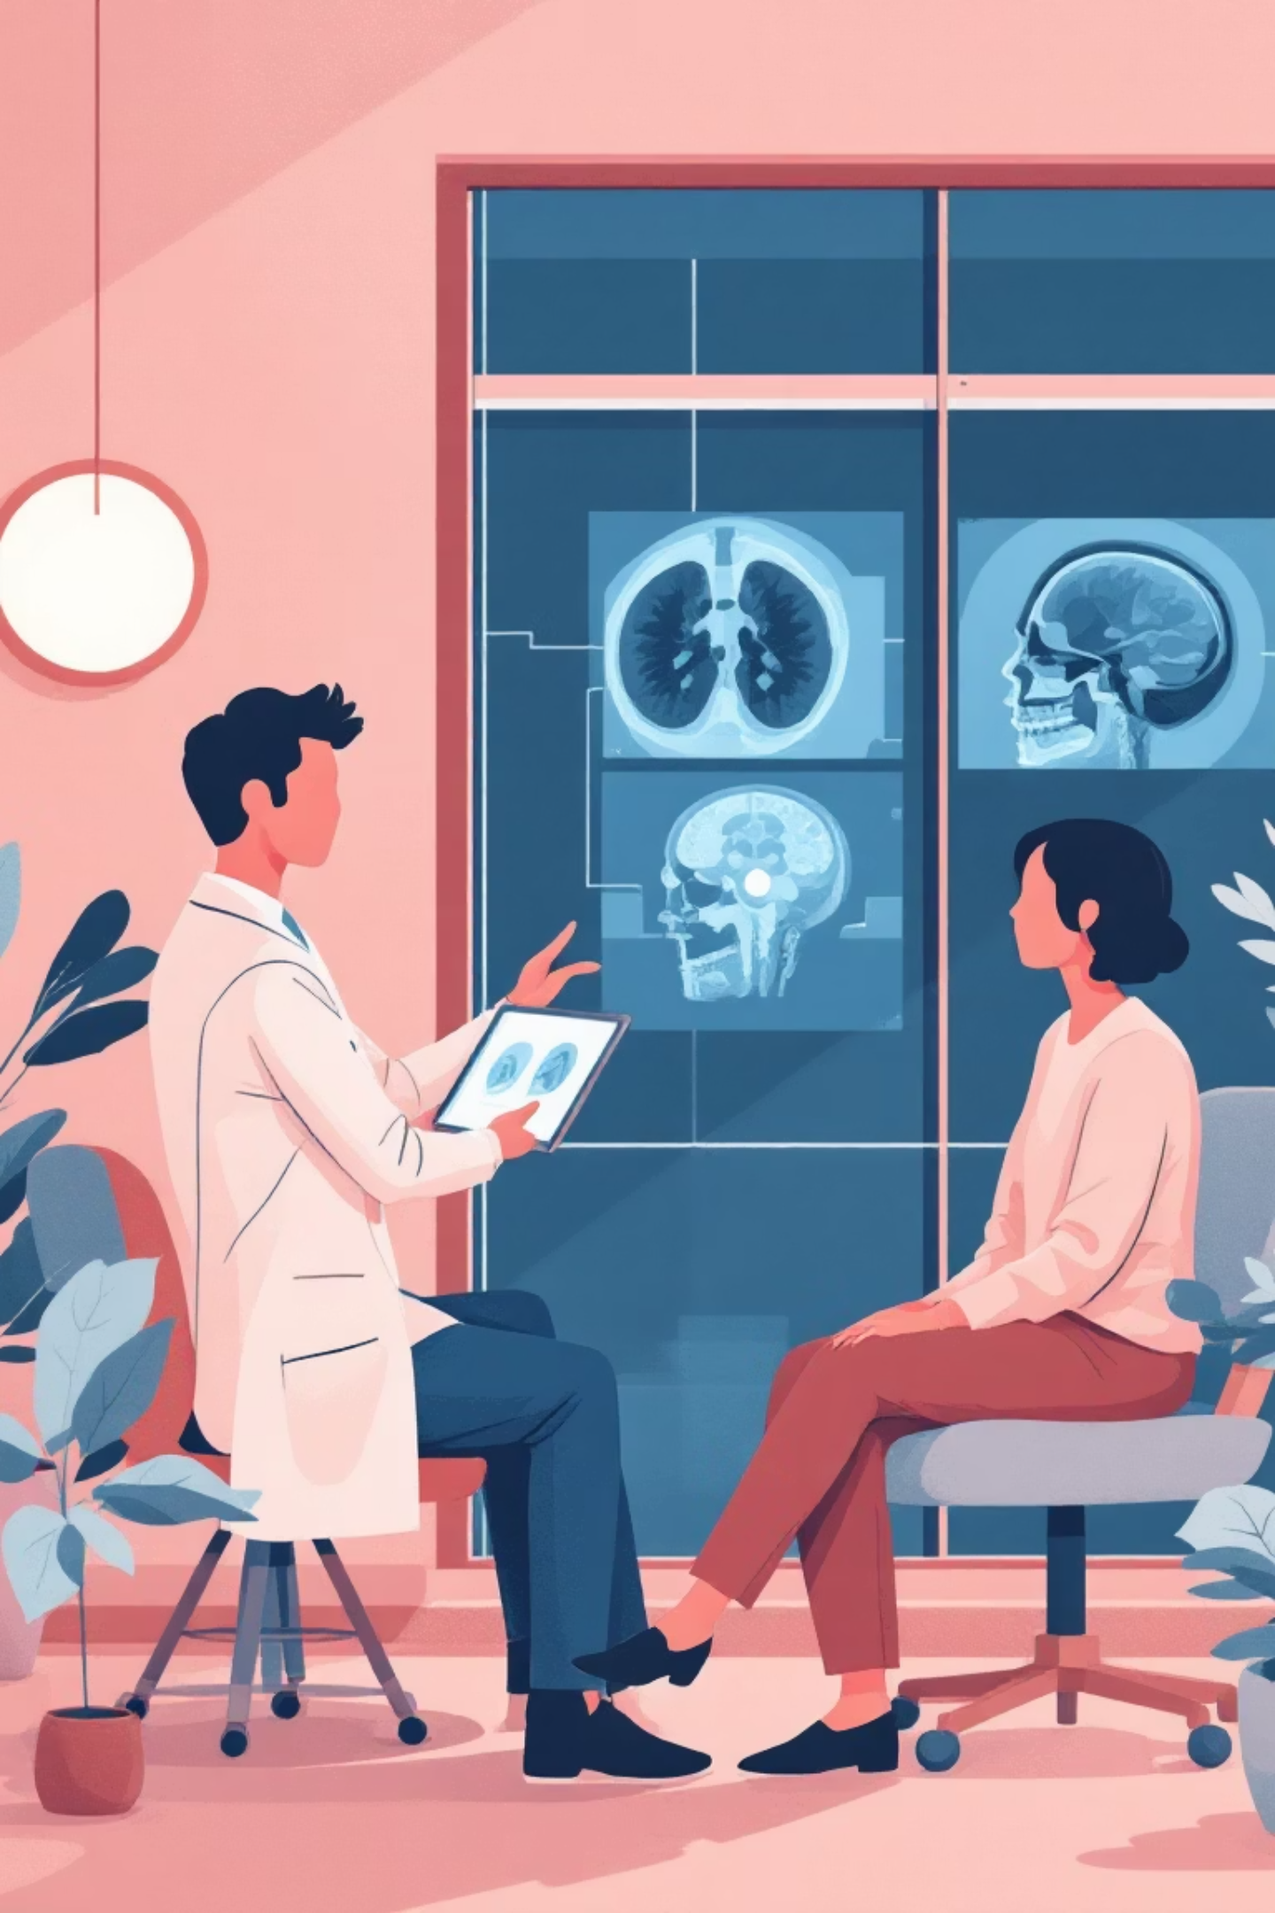
Objectives & Applications
Primary Objective
Secondary Objective
Design and implement a CNN (VGG19-based) to classify MRI scans as Tumour or Normal.
Deploy a user-friendly Flask web app for real-time uploads and predictions.
Applications
Automated diagnostics, telemedicine, research support, and improved healthcare access.

Slide 5
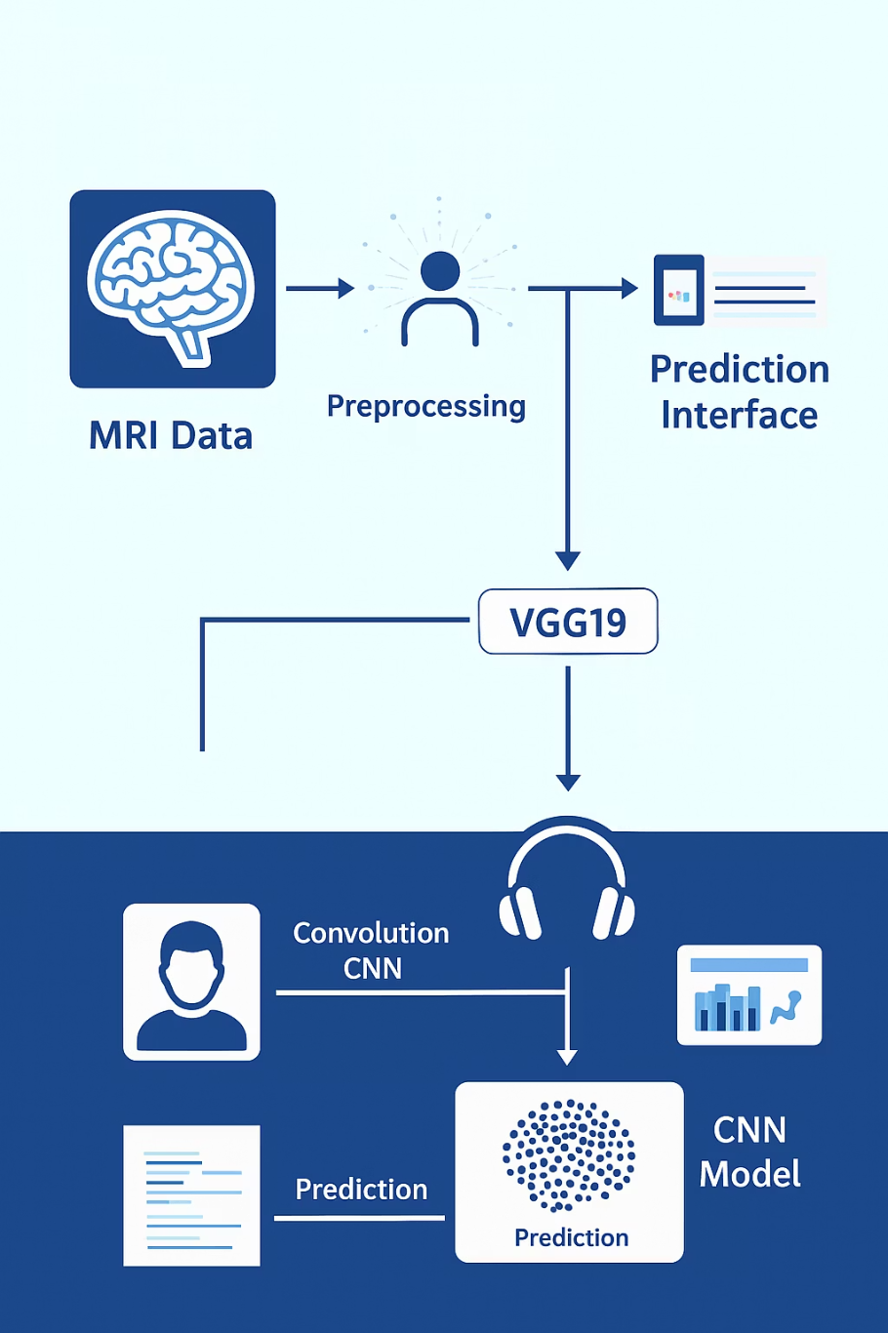
Project Features & Technical Approach
Key features: automatic image classification using VGG19 with transfer learning; preprocessing (resize, normalize) and augmentation to improve robustness; fine-tuning for high accuracy; Flask web UI for uploads and visualization; scalability for integration with hospital systems; data-driven insights and fast, reliable detection.
Model Pipeline
Data collection & labeling
Preprocessing & augmentation
Transfer learning with VGG19 & fine-tuning
Evaluation (accuracy, precision, recall, F1)
Deployment via Flask

Slide 6
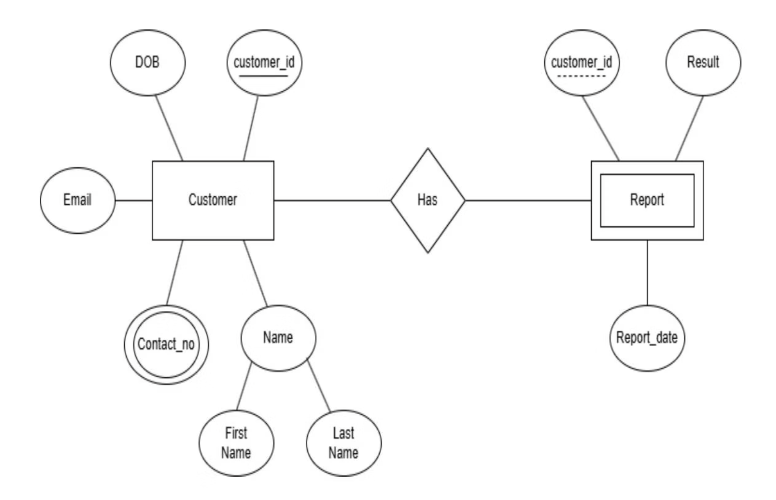
Entity Relationship Diagram

Slide 7
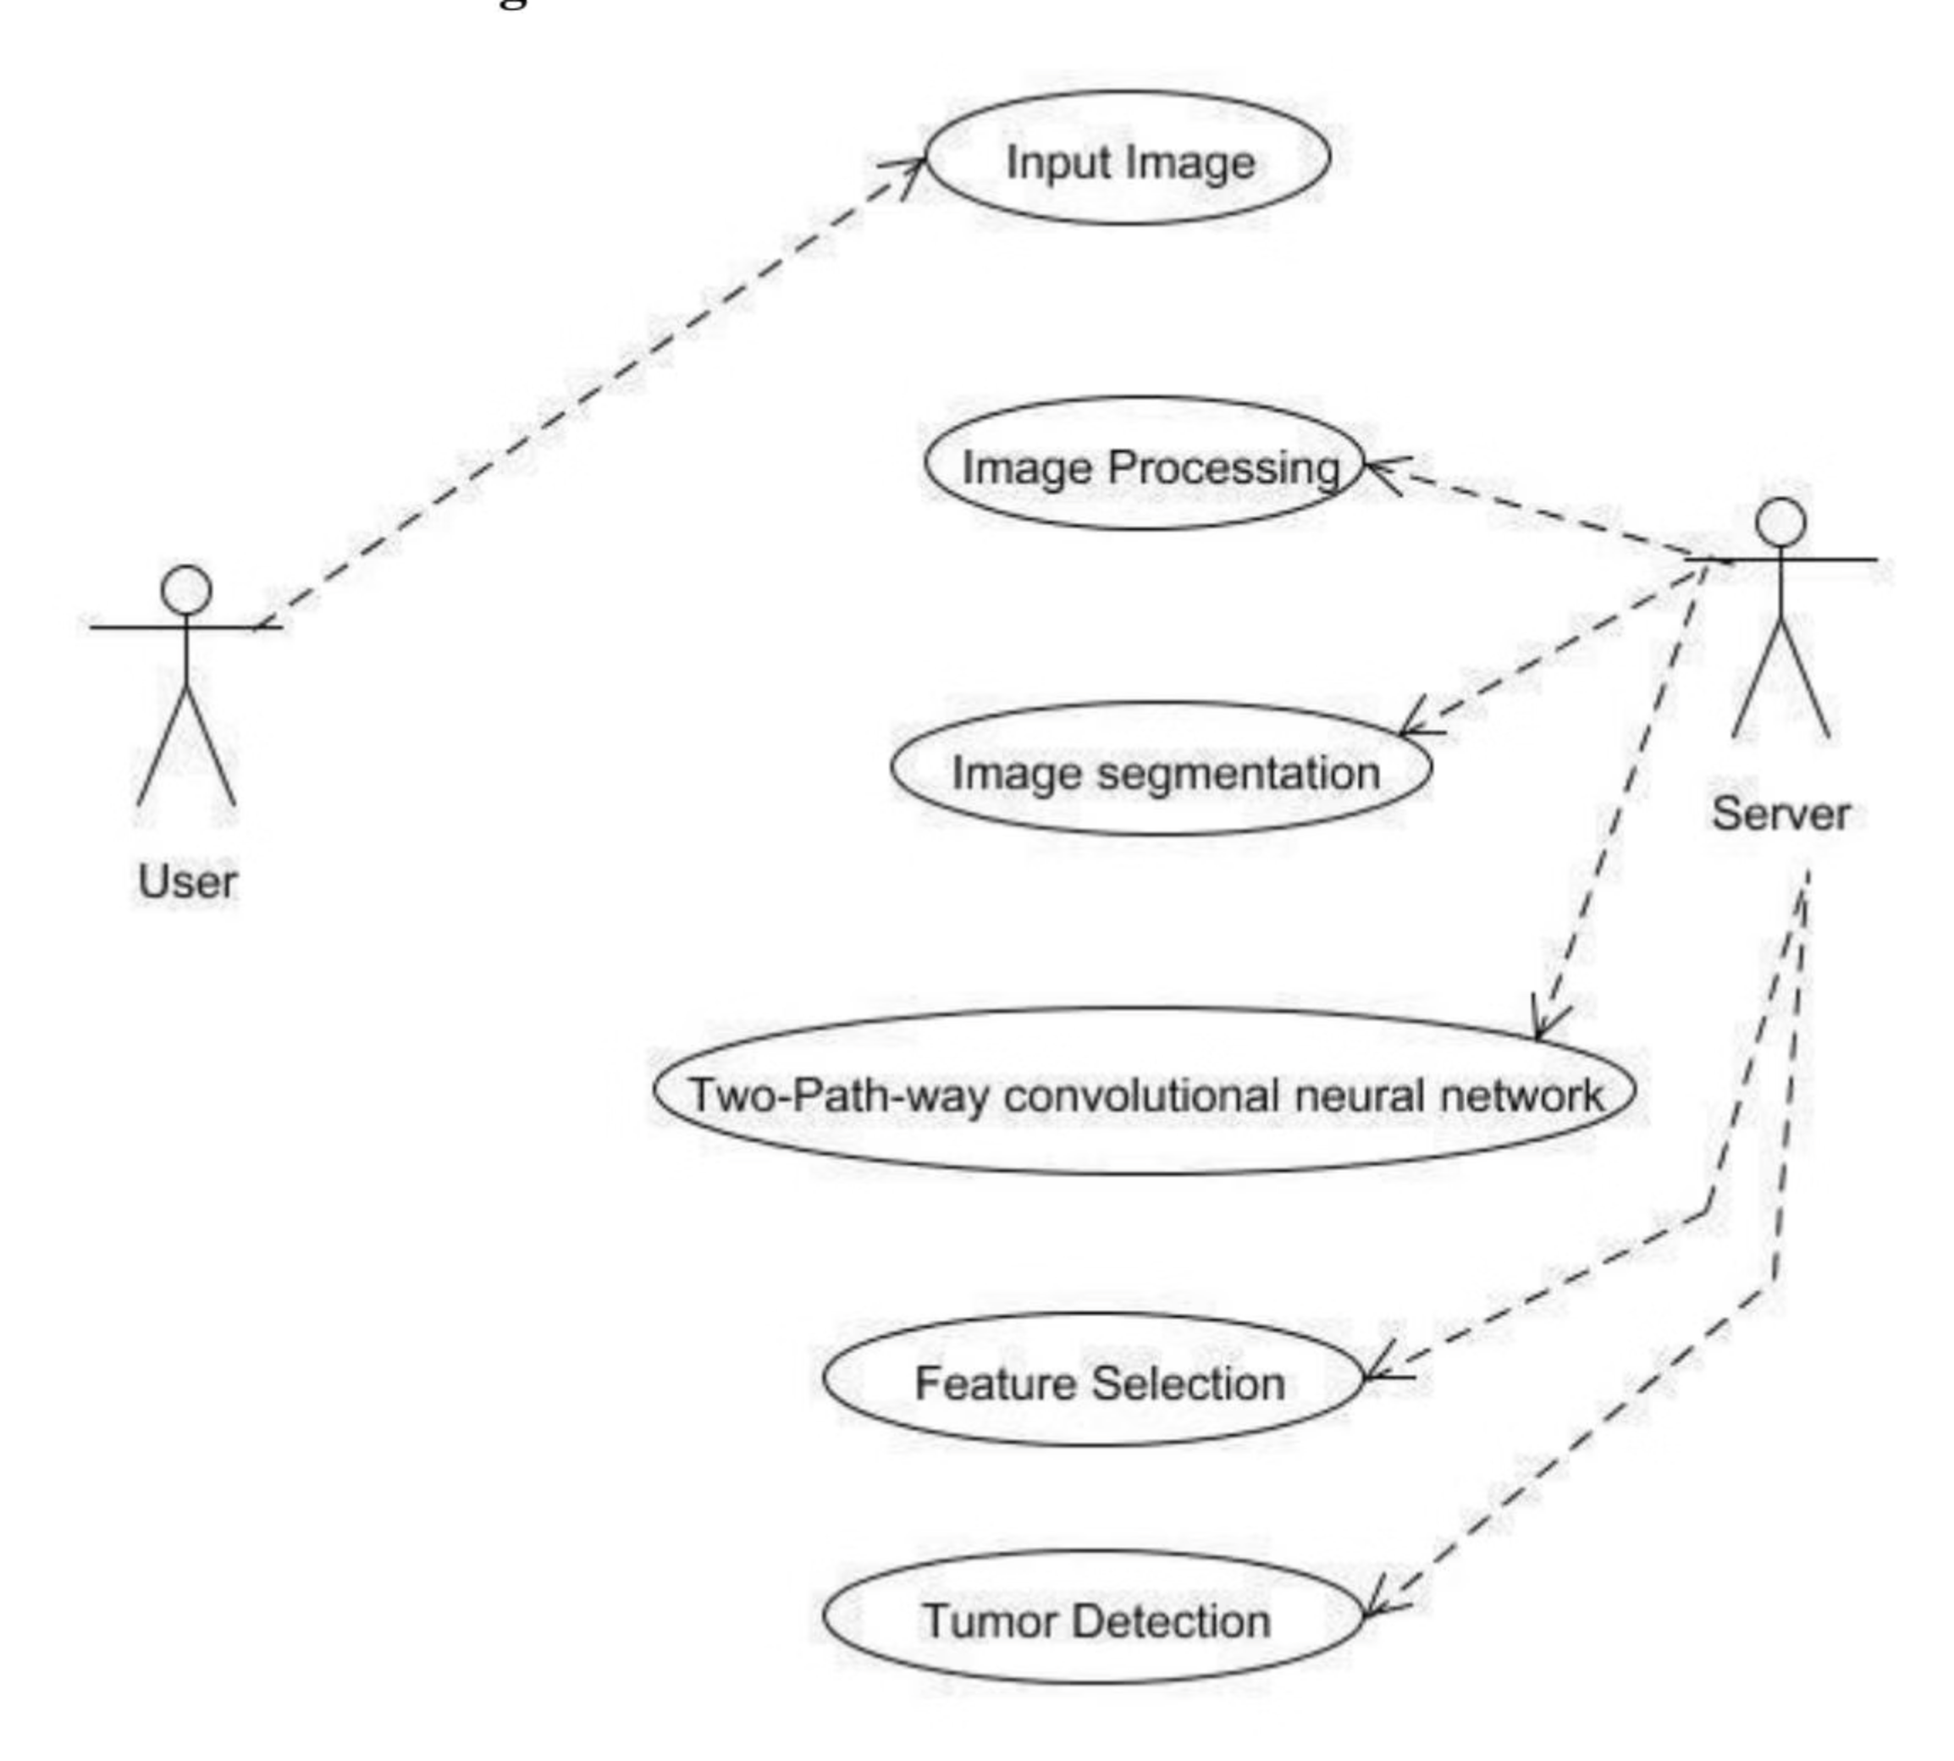
Use Case Diagram

Slide 8
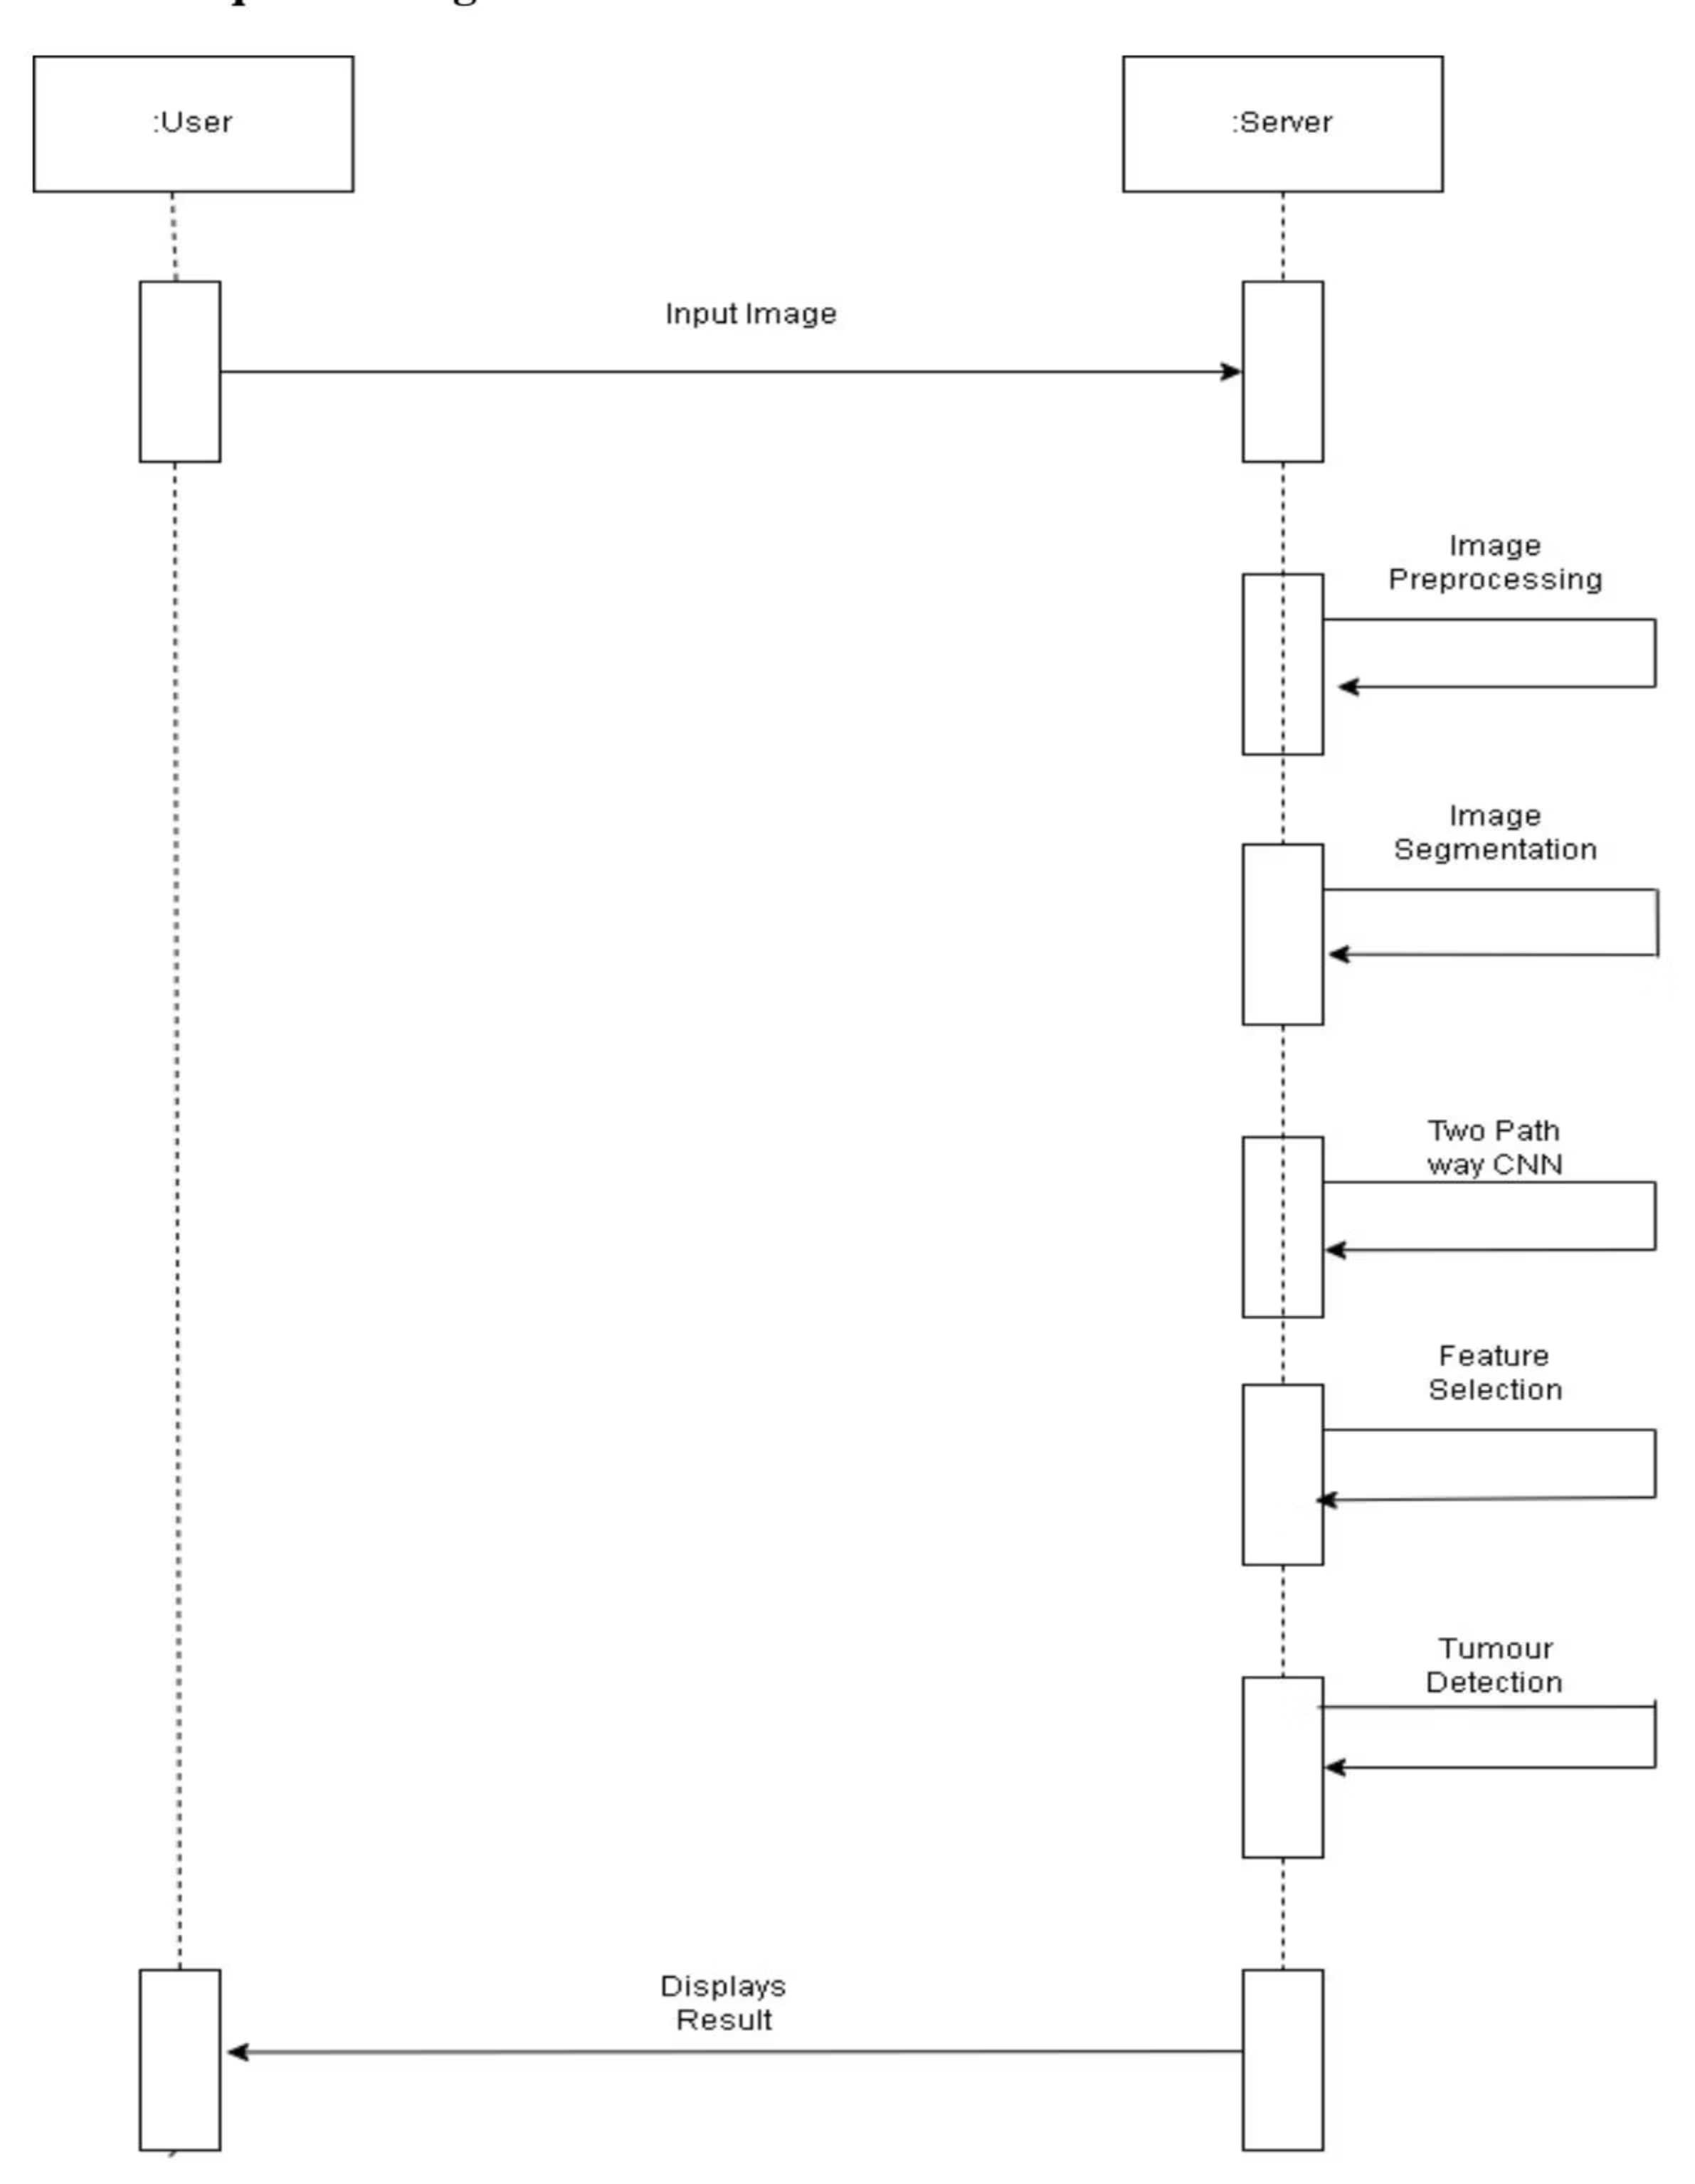
Sequence Diagram

Slide 9
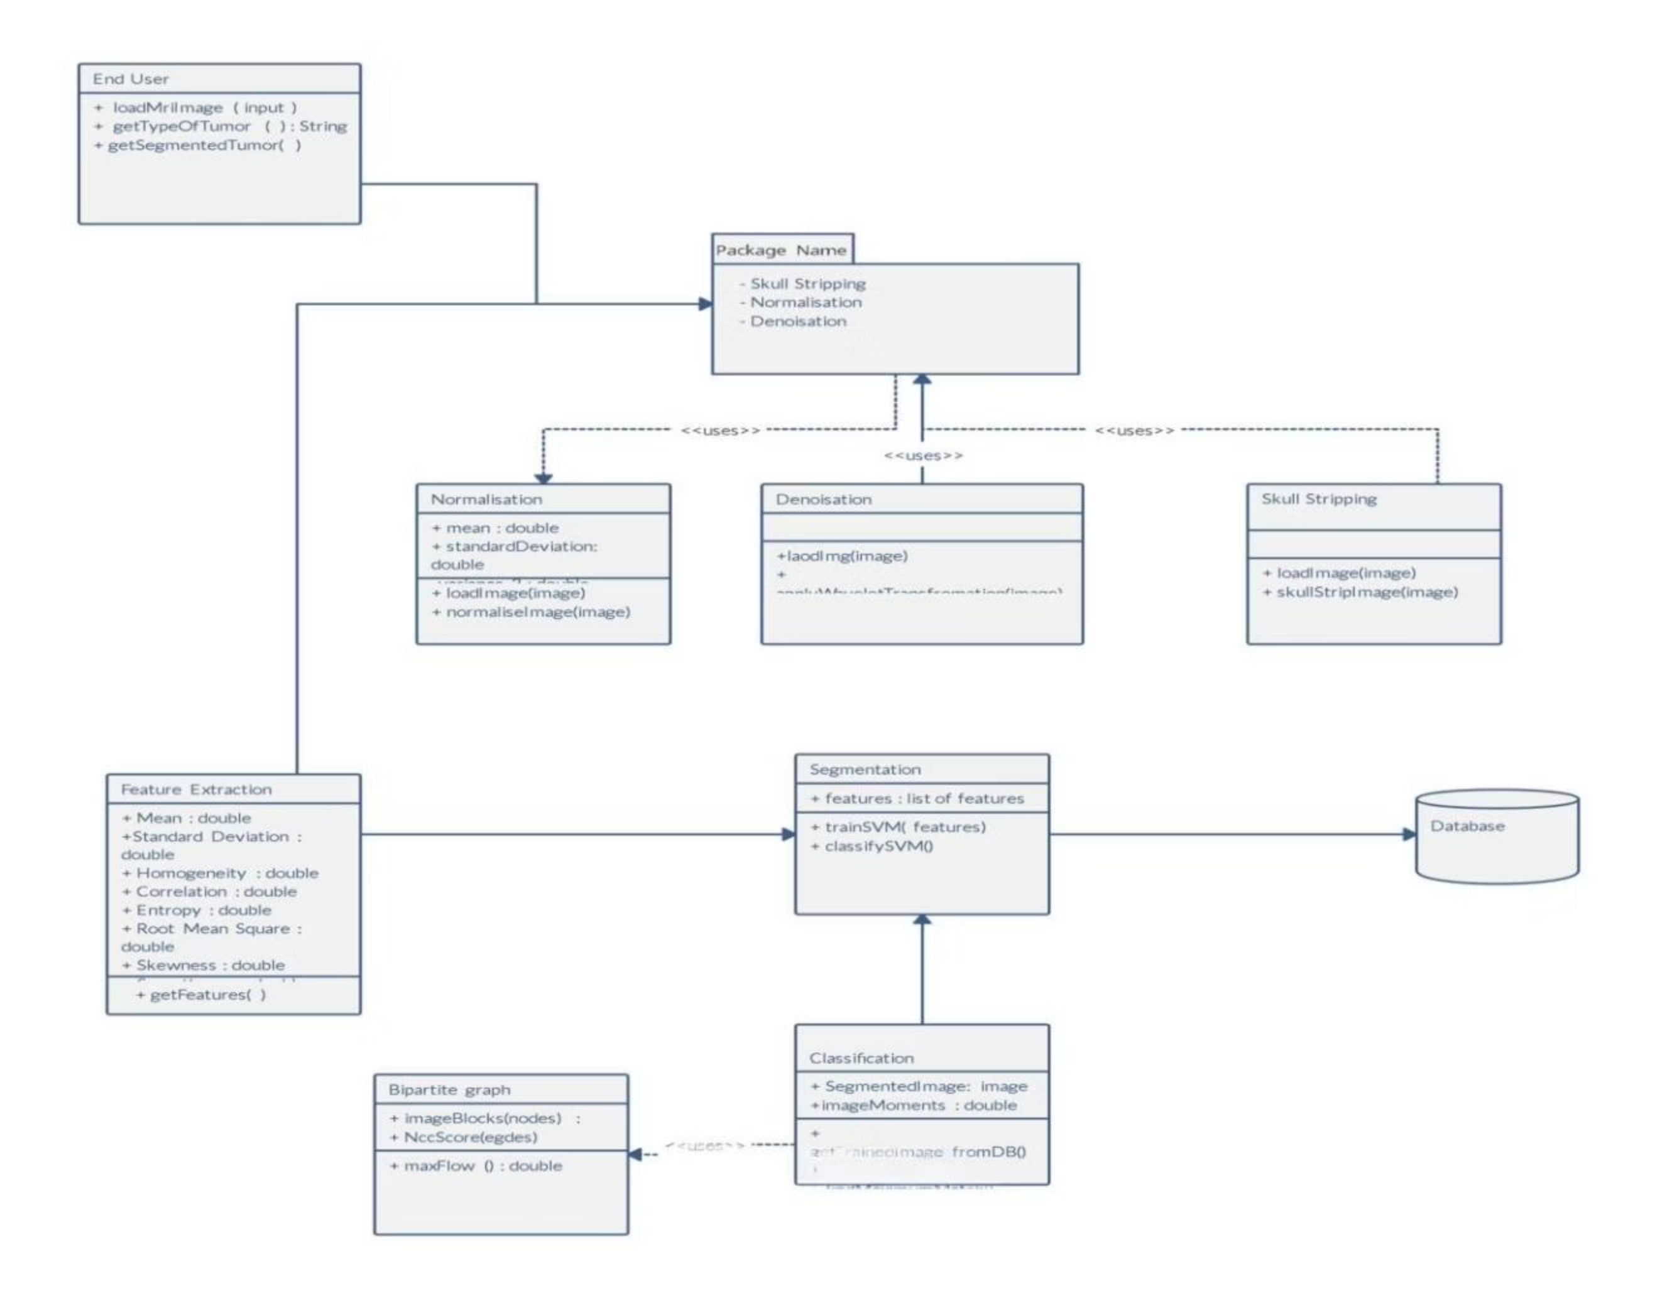
Class Diagram

Slide 10
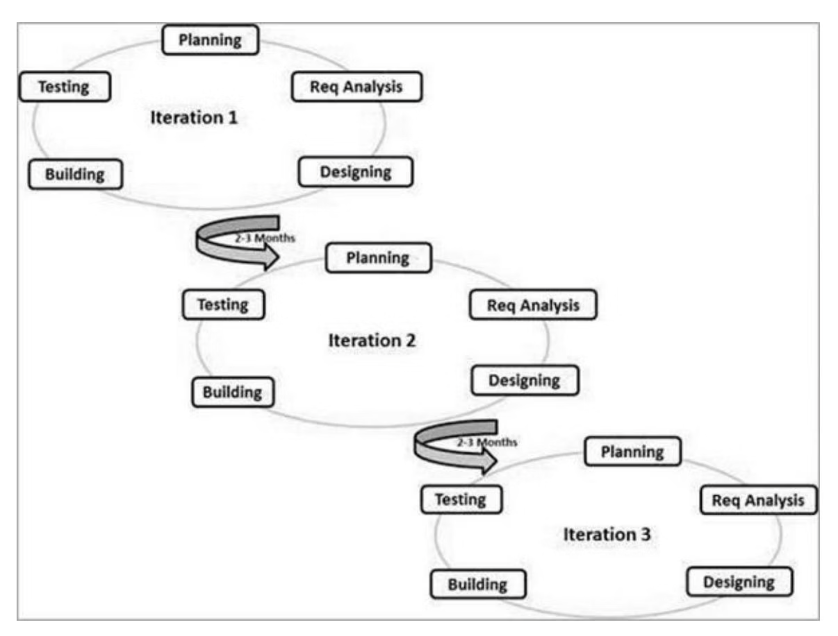
Agile Methodology
Agile is an iterative software development approach that emphasizes flexibility, collaboration, and continuous improvement through short development cycles called sprints.
SDLC Diagram

Slide 11
Estimated Project Timeline
Our training approach prioritizes efficiency, leveraging available hardware for rapid model development. Data acquisition is streamlined through direct integration with Kaggle, eliminating intermediate processing steps.
Overall Training Estimate
Expect training completion within approximately 7 to 8 hours when utilizing a laptop equipped with a dedicated GPU, such as an NVIDIA GTX 10-series or a more powerful equivalent. Training on a CPU, however, would significantly extend this duration to several days.
Workflow Breakdown and Time Estimates
Data Preparation (1–2 hours)
Data acquisition from Kaggle datasets.
Pre-processing and cleansing of image data.
Augmentation techniques (e.g., rotations, mirroring, scaling) to enhance dataset diversity.
Normalization of brightness and tone to meet VGG19 input requirements.
Model Setup and Configuration (approx. 30 minutes)
Initialization of a pre-trained VGG19 model architecture.
Modification of the final classification layers for specific task requirements.
Configuration of optimization parameters, including learning rate.
Model Training and Validation (7–8 hours)
Iterative training cycles with continuous monitoring of performance metrics.
Implementation of early stopping mechanisms to prevent overfitting.
Evaluation and Testing (1 hour)
Performance assessment using an independent test dataset to ensure model generalization and accuracy.
Factors Influencing Training Duration
Key determinants of training time include:
Dataset Size: The volume of data directly impacts processing time.
Image Resolution: Higher resolution images require more computational resources.
Batch Size: The number of samples processed per iteration affects training speed.
Additional time allocations include:
Hyperparameter Tuning (3–5 hours): Adjustments to learning rates, optimizers, and regularization techniques.
Deployment Preparation (2–3 hours): Environment setup and performance optimization for production.

Slide 12



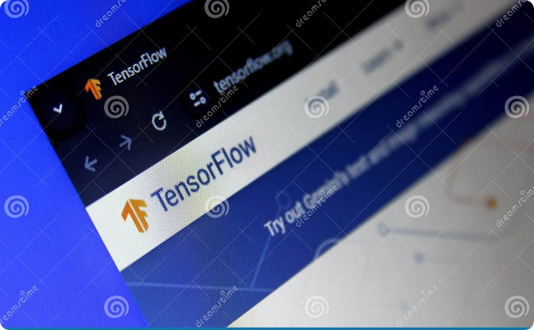


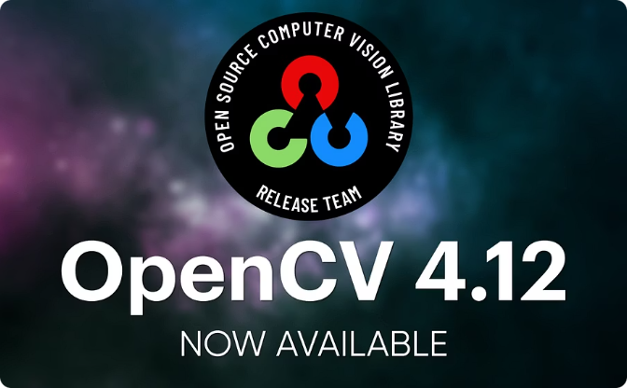

Technologies Used
Python
Docker
Kaggle
Primary programming language for development and data analysis.
Containerization platform for consistent development and deployment environments.
Platform used for dataset acquisition, experimentation, and model sharing.
TensorFlow
Flask
VGG19
Lightweight web framework for building APIs and web services.
Convolutional Neural Network architecture used for image recognition.
OpenCV React
For Front-end Deployment.
Library of python primarily aimed at real-time computer vision.

Slide 13
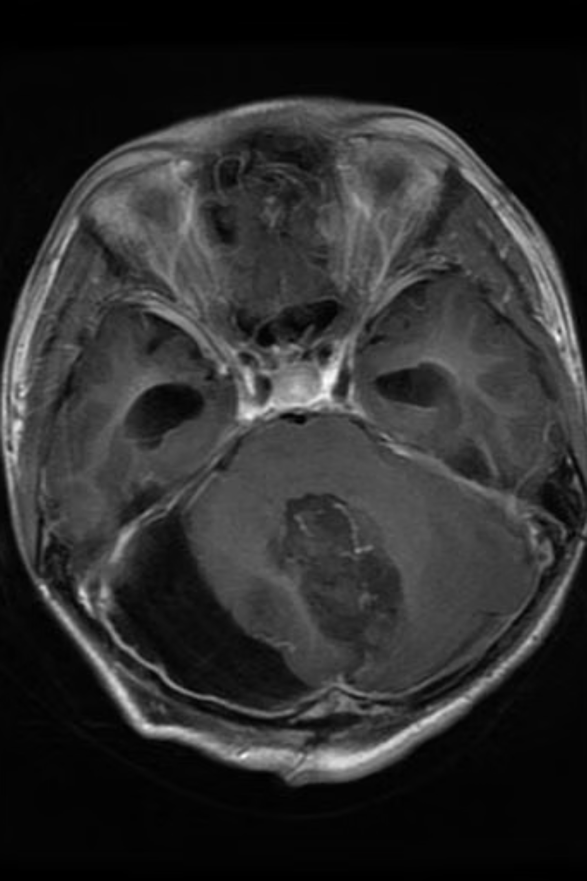
Expected Output, Results & Limitations
Expected outputs: per-image Tumour classification (Glioma, Meningioma, Pituitary, or Normal), confidence score, visual overlays, and model metrics (accuracy, precision, recall, F1—typically reported above 90% during testing). Results are presented in the Flask UI with downloadable reports.
Trade-offs & Design Decisions: We prioritized developing a complete working prototype over a fully production-ready system, focusing on proof-of-concept rather than clinical deployment. We chose VGG19 for its proven reliability over newer architectures to ensure consistent results within our timeline. While this limits explainability compared to attention-based models, it provided the stability needed for our educational objectives. We accepted dataset size constraints to demonstrate effective transfer learning techniques, showing how pre-trained models can work with limited medical data—a realistic scenario for many healthcare applications.
Performance
Fast inference when optimized; training requires GPU resources.
Safety & Trust
Add interpretability and clinical validation before production use.

Slide 14
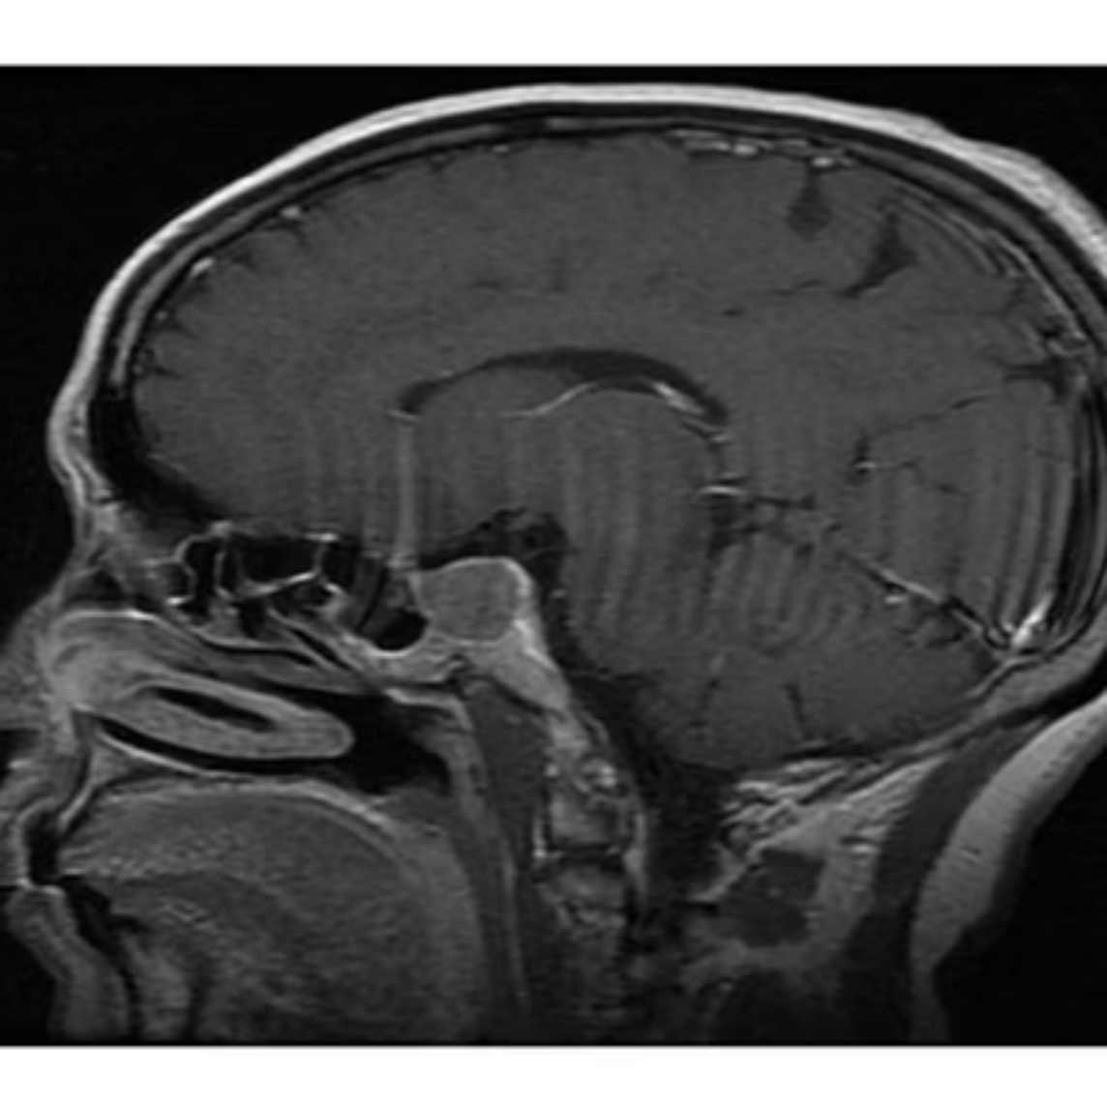
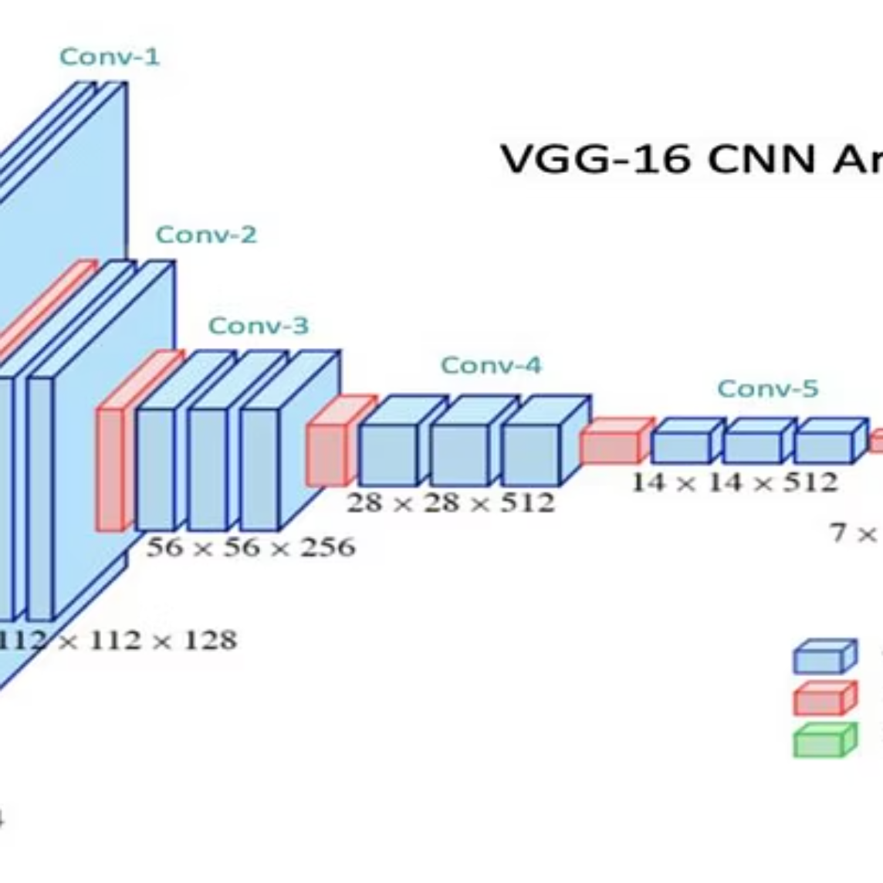
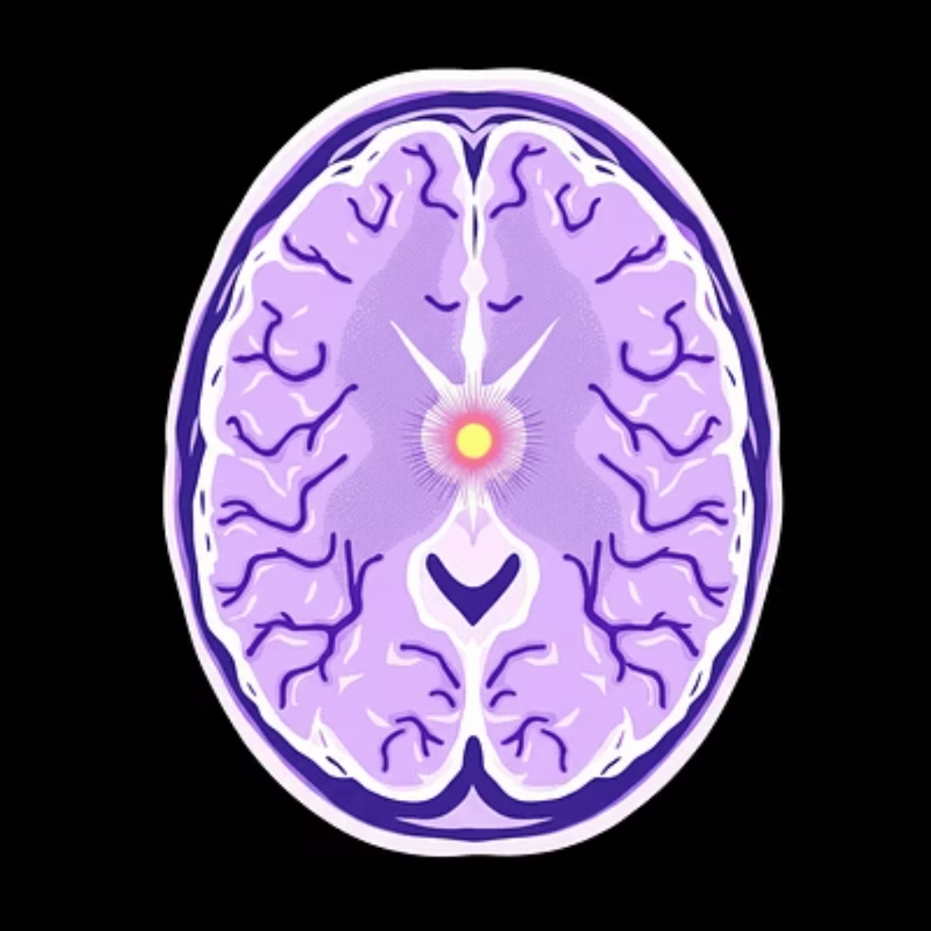
Conclusion, Recommendations & References
Conclusion: VGG19-based transfer learning combined with preprocessing and augmentation can produce a practical, high-accuracy brain tumour detection system. Recommendation: validate on multi-center datasets, incorporate explainability, and deploy via secure Flask service integrated with hospital workflows. Keep iterative testing and clinician feedback loops to ensure reliability and adoption.
Selected References
N. L. of Science, "Brain Tumor Detection Based on Deep Learning Approaches and MRI," 2023. pmc.ncbi.nlm.nih.gov/articles/PMC10453020
"Brain Tumor MRI Dataset," Masoud Nickparvar, 2021. kaggle.com
"Classification of brain tumors using ensemble learning," ScienceDirect.

Slide 15
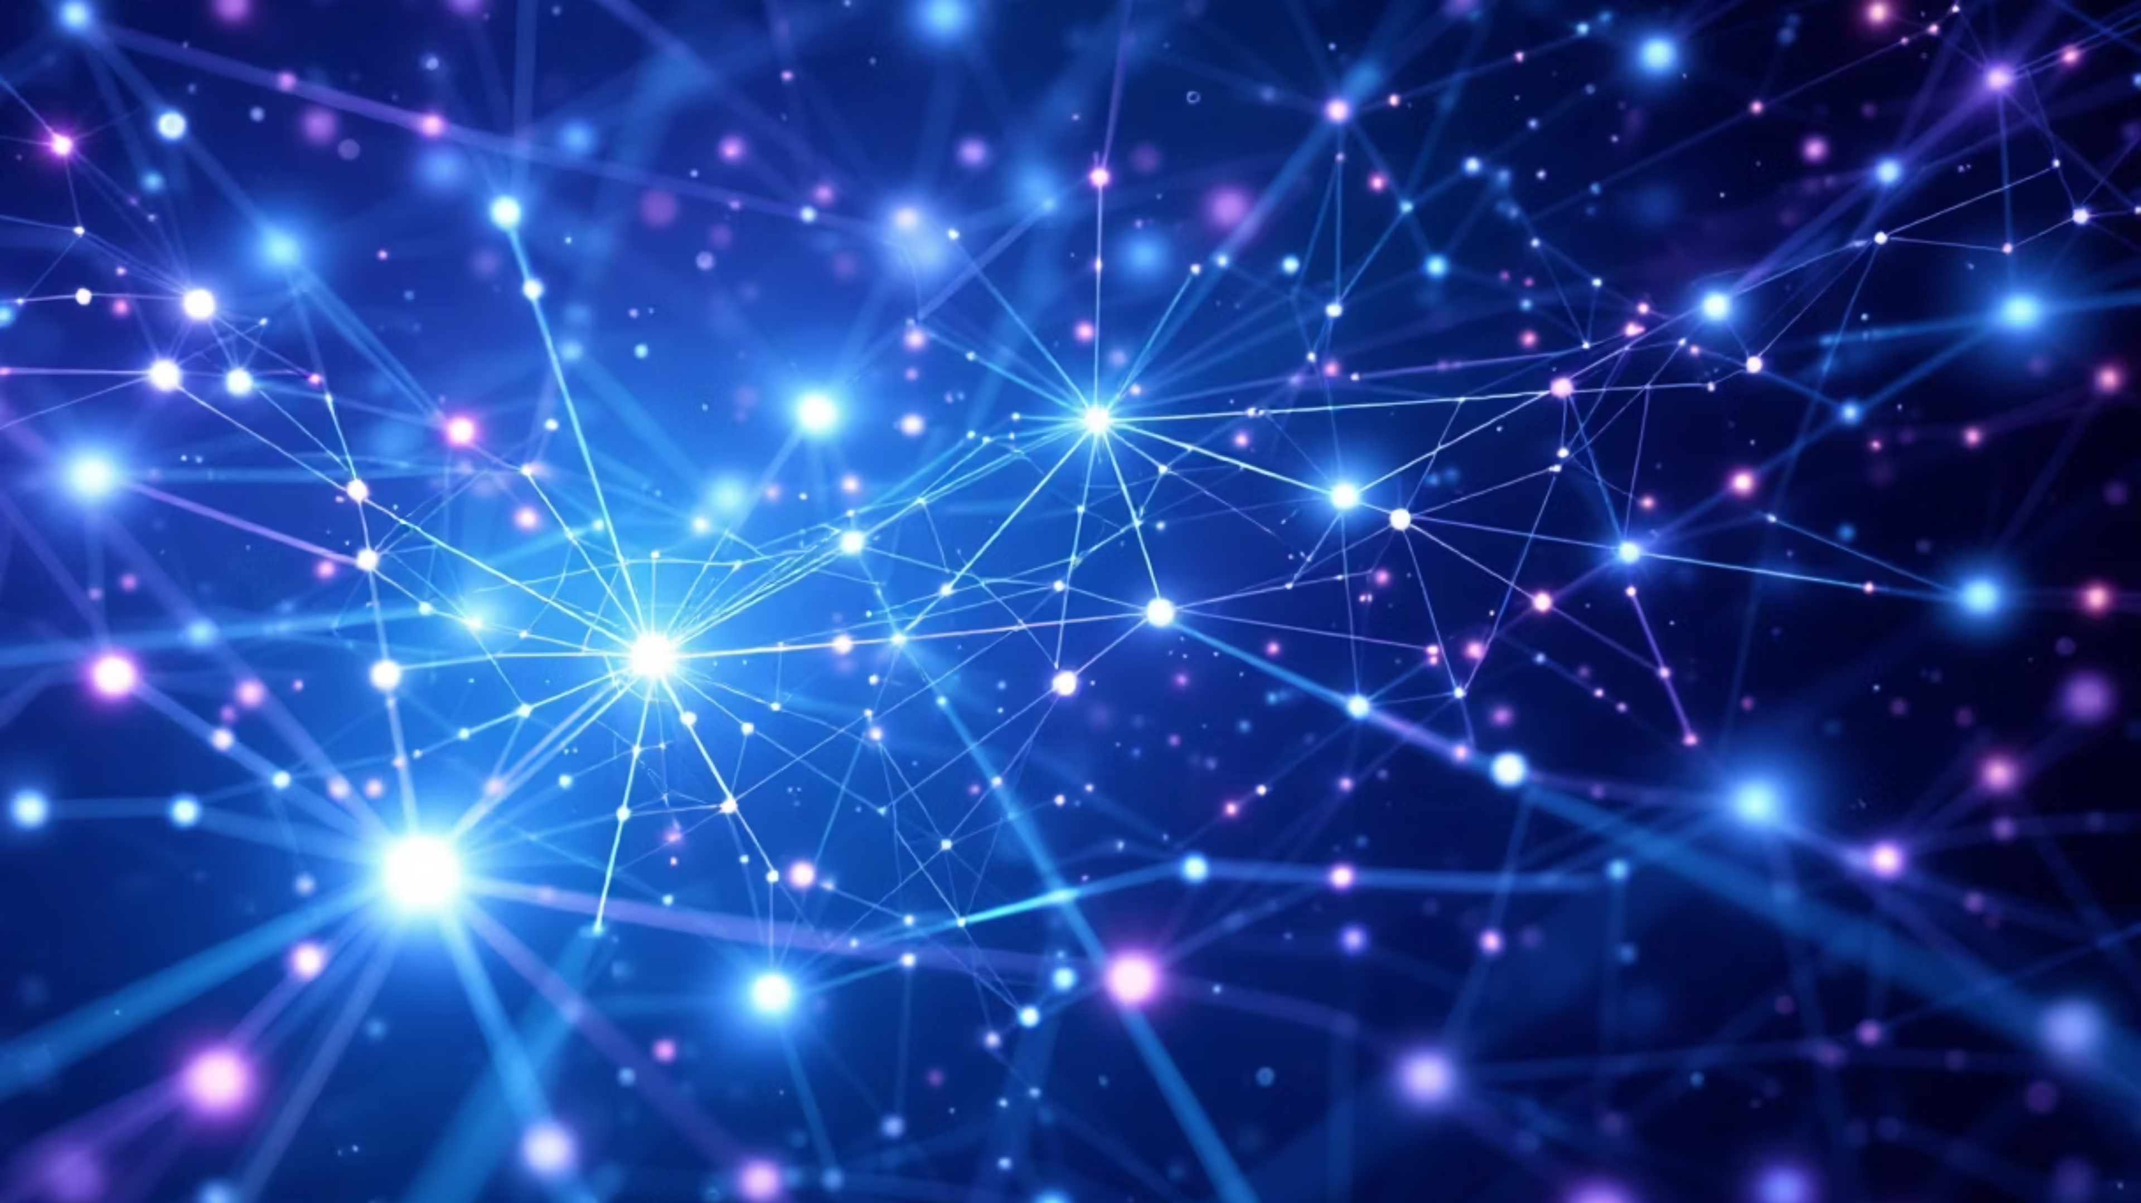
Thank You
We sincerely appreciate your time and attention to our presentation on "Brain Tumour Detection Using Machine Learning." Through this project, we will try to demonstrate how AI can transform medical diagnostics, making brain tumor detection faster, more accurate, and accessible to healthcare providers worldwide.
We are happy to answer any questions you may have.
Presented By:
Kamala Thapa (21185159)
Sankalpa Adhikari (21185177)
Sushil Adhikari (21185185)

